Slide 1

welcome
Team:
-Ahmed Mohamed Ghanem
(Design Patterns, two SOLID Principles )
-Hatem Mohamed Sabry
(Test Driven ,two SOLID Principles )
-Khaled Mohamad Arafa
(Architecture Patterns, one SOLID Principles )

Slide 2
Design Patterns
-Design patterns :are reusable solutions to commonly occurring problems in software design. They provide a structured approach to solving problems, you can improve code quality, maintainability, and scalability.
Design patterns can be classified into three categories:

Slide 3
.Creational Patterns
- Creational patterns focus on object creation mechanisms, providing flexibility in object creation while hiding the creation logic. Some commonly used creational patterns in Python include:
Singleton Pattern
Factory Pattern
Abstract Factory Pattern
Builder Pattern
Prototype Pattern
Let's take a look at an example of
the Factory Pattern:

Slide 4
.Structural Patterns
Structural patterns focus on the composition of classes and objects to form larger structures. They provide ways to simplify the relationships between objects, making the code more flexible and efficient. Some commonly used structural patterns in Python include:
Adapter Pattern
Decorator Pattern
Facade Pattern
Composite Pattern
Proxy Pattern
Let's take a look at an example of the Decorator Pattern:

Slide 5
Behavioral Patterns
Behavioral patterns focus on the interaction between objects, defining how they communicate and distribute responsibilities. They provide a way to organize the behavior of objects and make the code more maintainable and understandable. Some commonly used behavioral patterns in Python include:
Observer Pattern
Strategy Pattern
Command Pattern
Iterator Pattern
Template Method Pattern
Let's take a look at an example of the Observer Pattern:

Slide 6

Architecture Patterns
Architecture patterns are high-level design principles and guidelines that provide a structured approach to solving common architectural challenges. They serve as reusable solutions to design problems and help architects and developers create systems that are scalable, maintainable, and efficient.

Slide 7
Architecture Patterns layers
Domain: It is the highest level of abstraction and contains all the elements related to the problem and business logic. Here you can find Entities, Object Values, Aggregates and Services.
Adapters: They represent all the code that depends on a specific technology. For example, here we find the repository patterns for abstract querying and serializing objects in a storage system. But you can also find code to send emails using a given provider.
Service Layer: It takes care of orchestrating our workflows and defining the use cases of our system. It contains a sublayer and pattern called a Unit of Work that oversees the abstract of our idea of atomic operations.
Application Layer: is the connection point of a user or a system with the services layer. An example of an application layer could be an API or a command line tool.

Slide 8
some commonly used architecture patterns:
Layered Architecture: This pattern divides the system into logical layers, such as presentation, business logic, and data access layers. Each layer has specific responsibilities and communicates with adjacent layers through well-defined interfaces. It promotes separation of concerns and modularity.
Client-Server Architecture: In this pattern, the system is divided into client applications and server applications. Clients send requests to servers, which process the requests and return responses. It enables distributed computing and allows for scalability and flexibility.
Model-View-Controller (MVC): MVC is a popular architectural pattern for designing user interfaces. It separates the application into three interconnected components: the model (data and business logic), the view (presentation layer), and the controller (handles user input and coordinates interactions). It enhances maintainability and testability.

Slide 9
Model-View-Controller (MVC): MVC is a popular architectural pattern for designing user interfaces. It separates the application into three interconnected components: the model (data and business logic), the view (presentation layer), and the controller (handles user input and coordinates interactions). It enhances maintainability and testability.

Slide 10
SOLID Principles in Python
What are SOLID Principles?
The SOLID principles are a set of five design principles that aim to make software designs more understandable, flexible, and maintainable.
S: Single responsibility principle
O: Open/Closed principle
L: Liskov’s substitution principle
I: Interface segregation principle
D: Dependency inversion principle

Slide 11
Single Responsibility Principle (SRP)
A class should have only one reason to change, meaning it should have only one responsibility or job.
This principle encourages developers to design classes that are focused and have a clear purpose, making them easier to understand, maintain, and extend.
Example:

Slide 12
This class violates the single-responsibility principle because it has two reasons for changing its internal implementation. To fix this issue and make your design more robust, you can split the class into two smaller, more focused classes, each with its own specific concern:
Now you have two smaller classes, each having only a single responsibility.
The concept of responsibility in this context may be pretty subjective. Having a single responsibility doesn’t necessarily mean having a single method.

Slide 13
2.Open/Closed Principle (OCP)
Software entities (classes, modules, functions, etc.) should be open for extension but closed for modification.
This principle encourages developers to design systems that can be easily extended with new functionality without requiring changes to existing code.
Imagine that you need to add a new shape, maybe a square. How would you do that? Well, the option here is to add another elif clause to .__init__() and to .calculate_area(), Having to make these changes to create new shapes means that your class is open to modification. That violates the open-closed principle.
Here’s a possible solution:

Slide 14
This violates the Liskov subent-child relationship
One way to solve this problem is to create a base class for both Rectangle and Square to extend.
3.Liskov Substitution Principle (LSP)
Objects of a superclass should be replaceable with objects of its subclasses without affecting the correctness of the program.
This principle ensures that derived classes adhere to the contract established by their base classes, promoting polymorphism and code reuse.
.stitution principle because you can’t replace instances of Rectangle with their Square counterparts.While a square is a specific type of rectangle in mathematics, the classes that represent those shapes shouldn’t be in a par.

Slide 15
Interface Segregation Principle (ISP)
Clients should not be forced to depend on interfaces they don't use.
This principle encourages developers to design fine-grained interfaces that are specific to the needs of the clients that use them, rather than creating large, monolithic interfaces.
In this example, the base class, Printer, provides the interface that its subclasses must implement. OldPrinter inherits from Printer and must implement the same interface. However, OldPrinter doesn’t use the .fax() and .scan() methods because this type of printer doesn’t support these functionalities.
This implementation violates the ISP because it forces OldPrinter to expose an interface that the class doesn’t implement or need. To fix this issue, you should separate the interfaces into smaller and more specific classes. Then you can create concrete classes by inheriting from multiple interface classes as needed:

Slide 16
Now Printer, Fax, and Scanner are base classes that provide specific interfaces with a single responsibility each. To create OldPrinter, you only inherit the Printer interface. This way, the class won’t have unused methods. To create the ModernPrinter class, you need to inherit from all the interfaces. In short, you’ve segregated the Printer interface.
This class design allows you to create different machines with different sets of functionalities, making your design more flexible and extensible

Slide 17
Dependency inversion principle
High-level modules should not depend on low-level modules. Both should depend on abstractions.
Abstractions should not depend on details. Details should depend on abstractions.
This principle promotes loose coupling between modules by ensuring that high-level modules depend on abstractions (interfaces or abstract classes) rather than concrete implementations.
Say you’re building an application and have a FrontEnd class to display data to the users in a friendly way. The app currently gets its data from a database, so you end up with the following code
In this example, the FrontEnd class depends on the BackEnd class and its concrete implementation. You can say that both classes are tightly coupled. This coupling can lead to scalability issues. For example, say that your app is growing fast, and you want the app to be able to read data from a REST API. How would you do that?
You may think of adding a new method to BackEnd to retrieve the data from the REST API. However, that will also require you to modify FrontEnd, which should be closed to modification, according to the open-closed principle.
To fix the issue, you can apply the dependency inversion principle and make your classes depend on abstractions rather than on concrete implementations like BackEnd. In this specific example, you can introduce a DataSource class that provides the interface to use in your concrete classes:

Slide 18
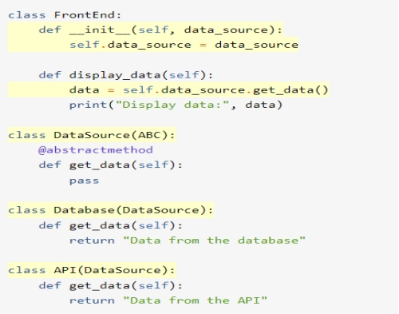
In this redesign of your classes:
You’ve added a DataSource class as an abstraction that provides the required interface, or the .get_data() method. Note how FrontEnd now depends on the interface provided by DataSource, which is an abstraction.
Then you define the Database class, which is a concrete implementation for those cases where you want to retrieve the data from your database. This class depends on the DataSource abstraction through inheritance.
Finally, you define the API class to support retrieving the data from the REST API. This class also depends on the DataSource abstraction.

Slide 19
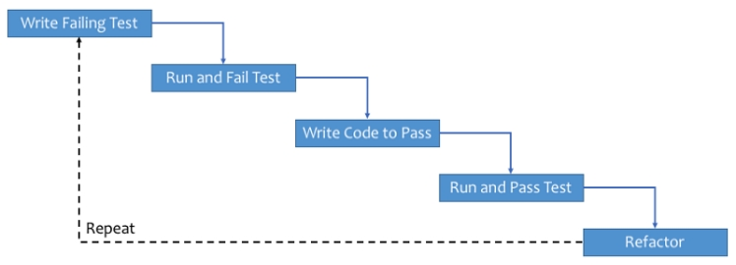
Test Driven Development with python
What Is Test-Driven Development?
TDD is the process of implementing code by writing your tests first, seeing them fail, and then writing the code to make the tests pass. You can then build upon this developed code by appropriately altering your test to expect the outcome of additional functionality, before writing the code to make it pass again.
Syntax for Unit Testing
The main methods that we make use of in unit testing for Python are:
assert: base assert allowing you to write your own assertions
assertEqual(a, b): check a and b are equal
assertNotEqual(a, b): check a and b are not equal
assertIn(a, b): check that a is in the item b
assertNotIn(a, b): check that a is not in the item b
assertFalse(a): check that the value of a is False
assertTrue(a): check that the value of a is True
assertIsInstance(a, TYPE): check that a is of type TYPE
assertRaises(ERROR, a, args): check that when a is called with args, it raises ERROR
Workflow Of TDD:
General workflow of TDD

Slide 20
The TDD cycle consists of the following steps:
Write a test: Start by writing a test that defines the expected behavior of a specific piece of functionality. This test is often written as a function or method that asserts certain conditions or outcomes.
Run the test: Execute the test to verify that it fails. This is an important step because it ensures that the test is valid and the expected behavior is not already implemented.
Write the code: Implement the minimal amount of code necessary to make the test pass. Focus on solving the specific problem addressed by the test, rather than adding unnecessary functionality.
Run the test again: Execute the test again to check if the code change has successfully made the test pass. If the test fails, iterate and modify the code until the test passes.
Refactor the code: Once the test passes, you can refactor the code to improve its design, structure, or performance while keeping the tests passing. Refactoring ensures that the code remains clean and maintainable.
Repeat the cycle: Move on to the next feature or piece of functionality and repeat the process. Write a new test, run it (which should fail initially), write the code to make it pass, and continue the cycle.

Slide 21
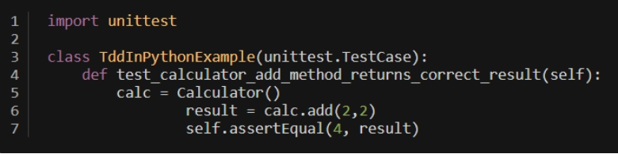
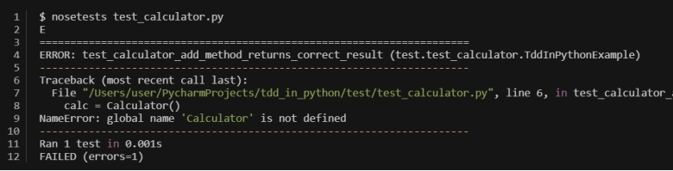
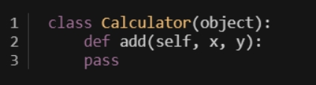
Example Problem and Test-Driven Approach:
Create a file named test_calculator.py in the test directory with the following contents.
Now you will use the nosetest runner to execute the test. You could execute the test using the standard unittest runner
From the output nosetest has given us, we can see that the problem relates to us not importing Calculator. That's because we haven't created it yet! So let's go and define our Calculator in a file named calculator.py under the app directory and import it:
app/calculator.py

Slide 22
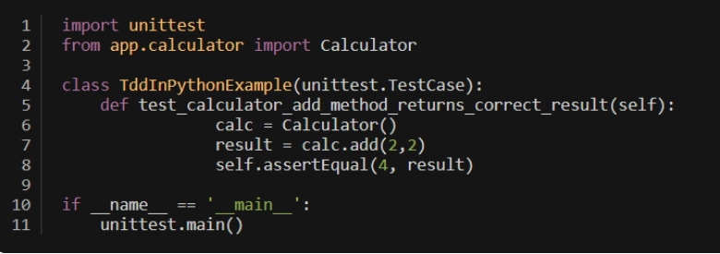
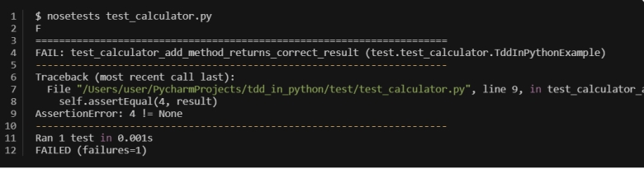
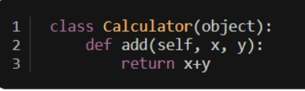
test_calculator.py
Now that we have calculator defined, let's see what nosetest indicates to us now:
So, obviously, our add method is returning the wrong value, as it doesn't do anything at the moment. Handily, nosetest gives us the offending line in the test, and we can then confirm what we need to change. Let's fix the method and see if our test passes now:
calculator.py

Slide 23
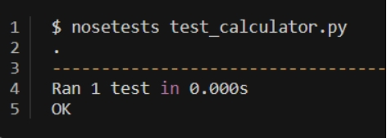
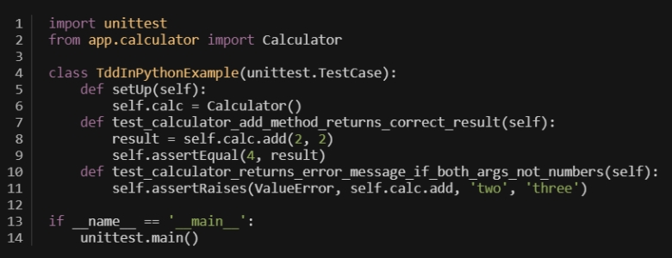
Output
Success! We have defined our add method, and it works as expected. However, there is more work to do around this method to ensure that we have tested it properly.
What would happen if someone were to add anything other than numbers? Python will actually allow for the addition of strings and other types, but in our case, for our calculator, it makes sense to only allow adding of numbers. Let's add another failing test for this case, making use of the assertRaises method to test if an exception is raised here:
test_calculator.py

Slide 24
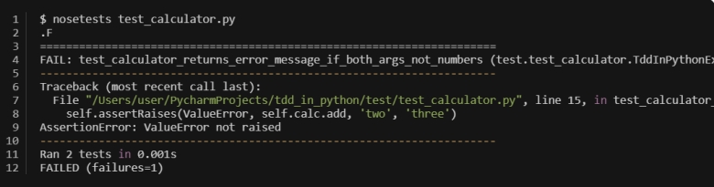
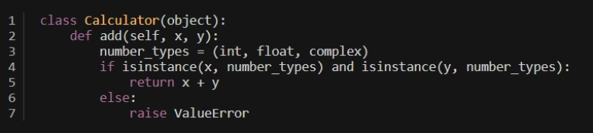
You can see above that we added the test and are now checking for a ValueError to be raised if we pass in strings. We could also add more checks for other types, but for now, we'll keep things simple. You may also notice that we've made use of the setup() method. This allows us to put things in place before each test case. So, as we need our Calculator object to be available in both test cases, it makes sense to initialize this in the setUp method. Let's see what nosetest indicates to us now:
Clearly, nosetests indicates to us that we are not raising the ValueError when we expect to be. Now that we have a new failing test, we can code the solution to make it pass.
From the code above, you can see that we've made a small addition to check the types of the values and whether they match what we want. One approach to this problem could mean that you follow duck typing and simply attempt to use it as a number, and try/except the errors that would be raised in other cases. The above is a bit of an edge case and means we must check before

Slide 25
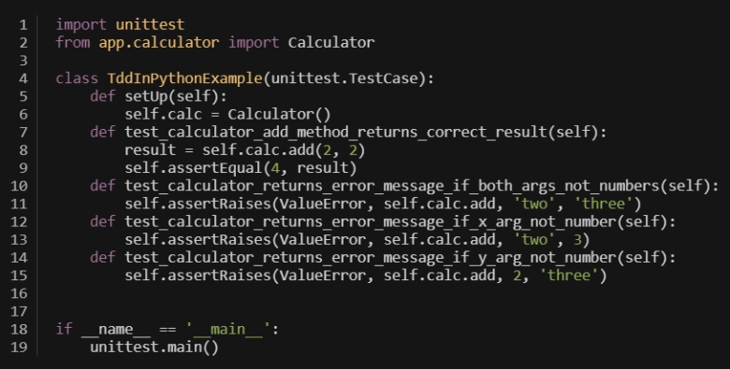
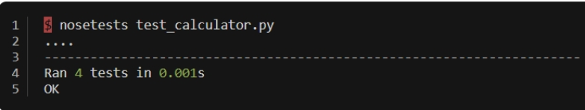
moving forward. As mentioned earlier, strings can be concatenated with the plus symbol, so we only want to allow numbers. Using the isinstance method allows us to ensure that the provided values can only be numbers.
To complete the testing, there are a couple of different cases that we can add. As there are two variables, it means that both could potentially not be numbers. Add the test case to cover all the scenarios.
When we run all these tests now, we can confirm that the method meets our requirements!
Unit Test Packages:
Pytest
Unittest
Nosetest

Slide 26

Thank you

